Slide 1
BDD microskill crafting constraints through tests
@LlewellynFalco

Slide 2
BDD vs Evil Programmer
@LlewellynFalco

Slide 3
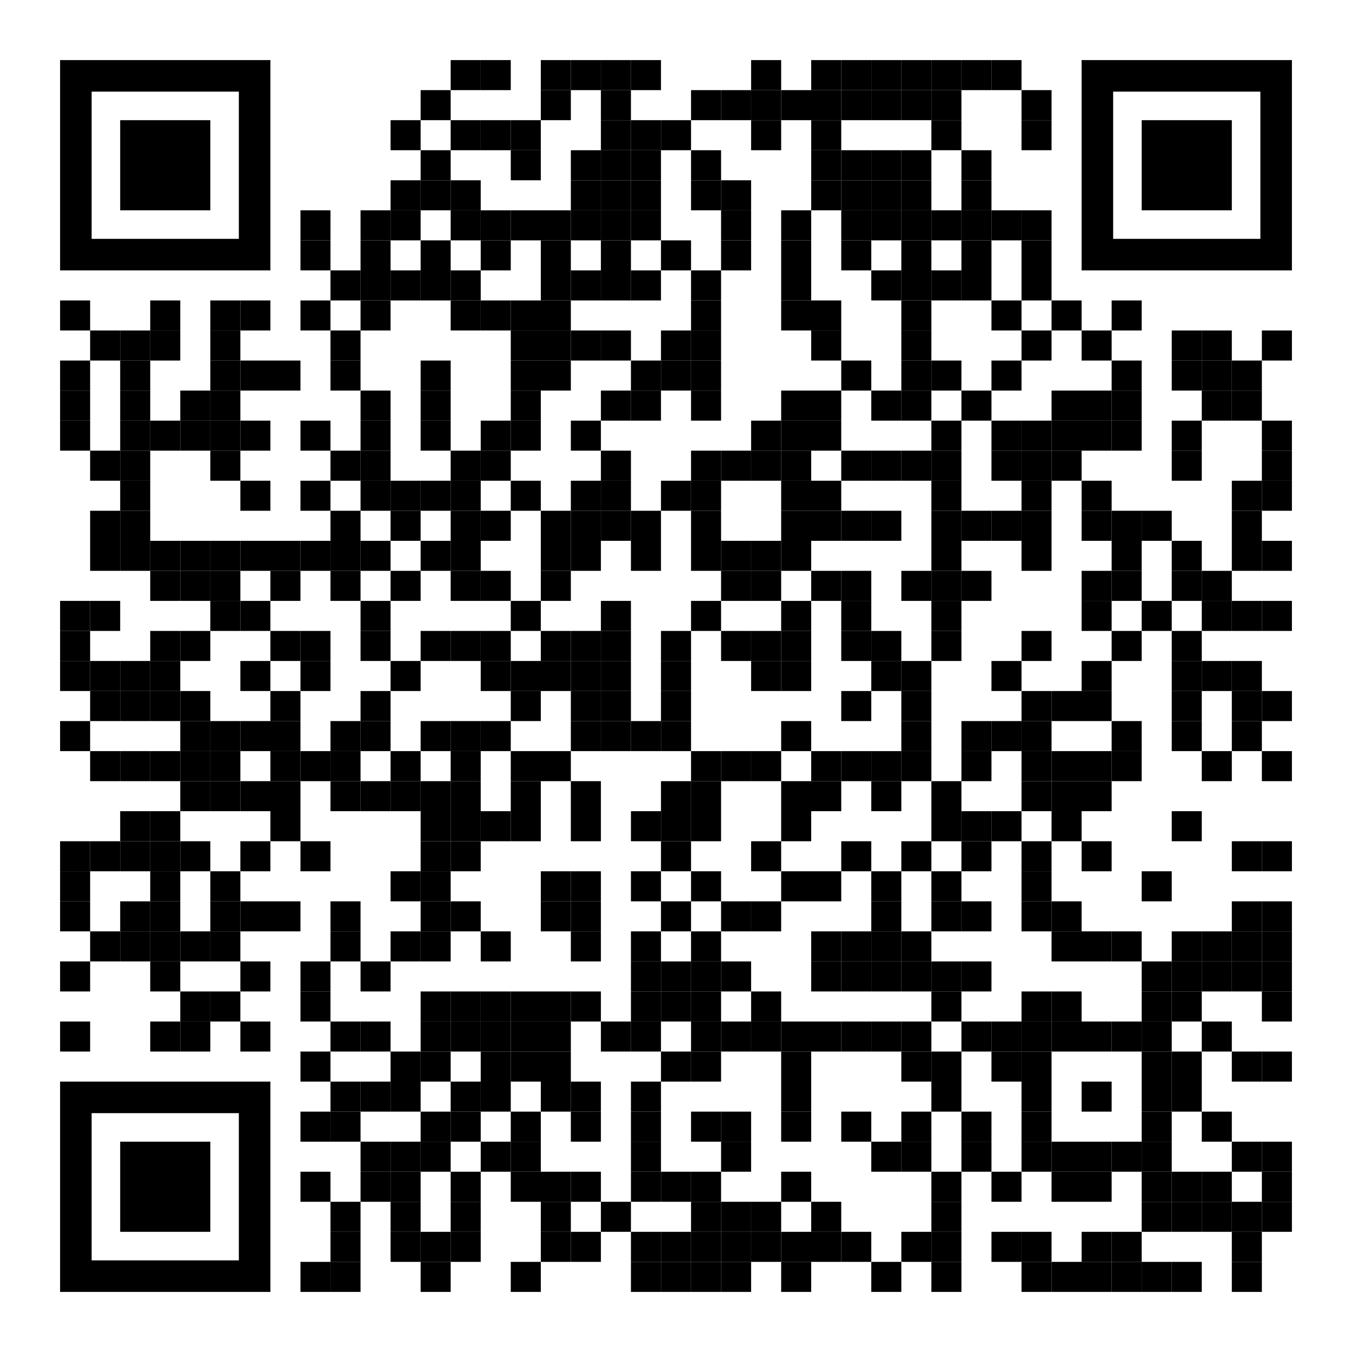
https://github.com/isidore/Talks/blob/master/BDDvsEvilProgrammer.md

Slide 4
Rules:

Slide 5
Rule #1 All tests must pass

Slide 6
Rule #2 I’m not trying to help

Slide 7
Rule #3 But I’m also lazy

Slide 8

Rules for Test Scenarios
In the Past
The past already happened. No if’s or conditionals, no branches.
Sam might go to a store sometime tomorrow.
Sam went to the video store at 11:15 yesterday
Specific Details
The devil is in the details. Make sure they are clear
Create a game board.
Create a crossword board that is 18 x 23
Avoid Symmetry
Symmetry is a smell in test as you can easily get a false positive
Place a piece at (5,5).
Place a piece at (4,5)
Happy Path
Sketch out the main things that can go right before focusing on what can go wrong
It’s illegal to place a piece on an …
Player 1 puts an X in the middle to win
Reality is Optional
You only need to use realistic situations when they are also convenient. Otherwise, don’t
Password = 2FX_V?Az8Wm/9CuZ%
Password = Password
Start Simple
You are building complexity, don’t start with it.
3*5/4² = 0.9375
1+1 = 2

Slide 9
Given When Then

Slide 10
Working
Refinement
Reporting
New Feature

Slide 11
https://github.com/isidore/Talks/blob/master/BDDvsEvilProgrammer.md

Slide 12

Thank YOU (please connect via LinkedIn and Twitter)
@LlewellynFalco
youtube.com/isidoreus
LlewellynFalco.Blogspot.com approvaltests.com

